Slide 1

Name: Rachamadugu Sudheer Kumar
SkillsBuild Email ID : rsudheerkumar40@gmail.com
College Name : RISE Krishna Sai Prakasam Group of Institutions
College State : Andhra Pradesh
Internship Domain : Artificial Intelligence
Internship StartDate : 5th June 2023

Slide 2
Employee Burnout Analysis
Employee Burnout Analysis

Slide 3
AGENDA
Data Loading
Data Visualization
Data Pre-Processing
Random Forest

Slide 4
Introduction
Employee Burnout Analysis with multi linear regression. Employee burnout has become a prevalent issue in today's fast-paced and demanding work environments. It is characterized by physical and emotional exhaustion, cynicism, and reduced personal accomplishment, leading to decreased productivity and increased turnover rates.

Slide 5
Data Loading

Slide 6
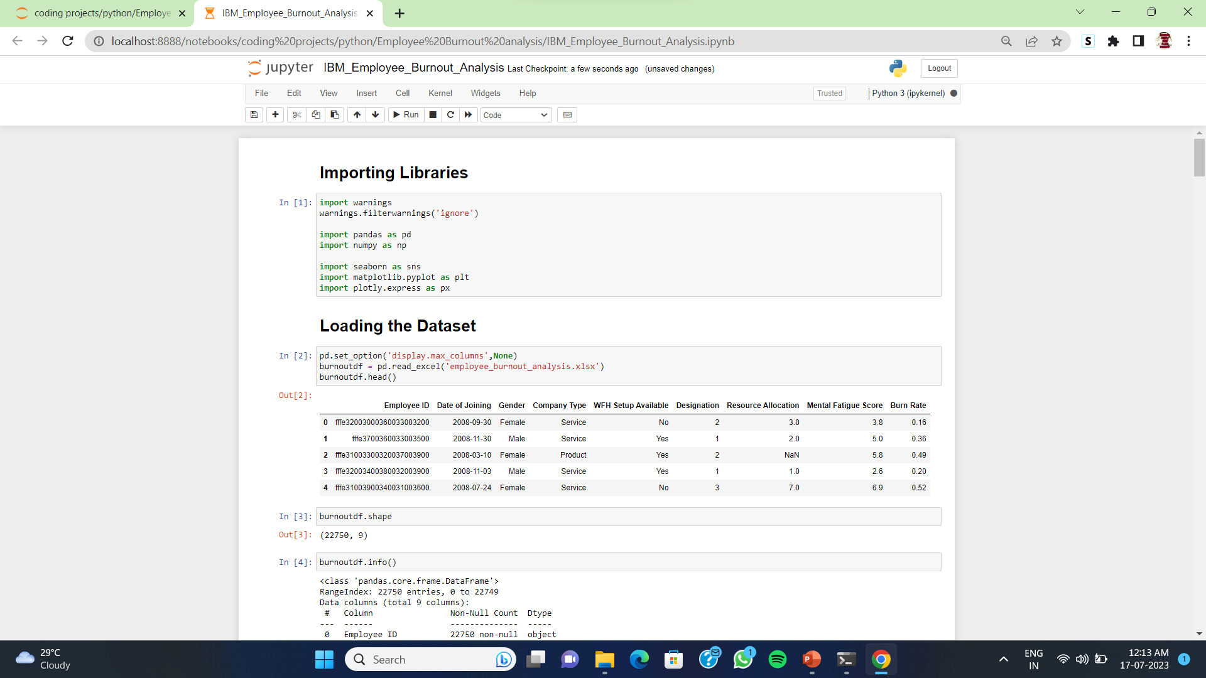

Slide 7
Data Visualization

Slide 8
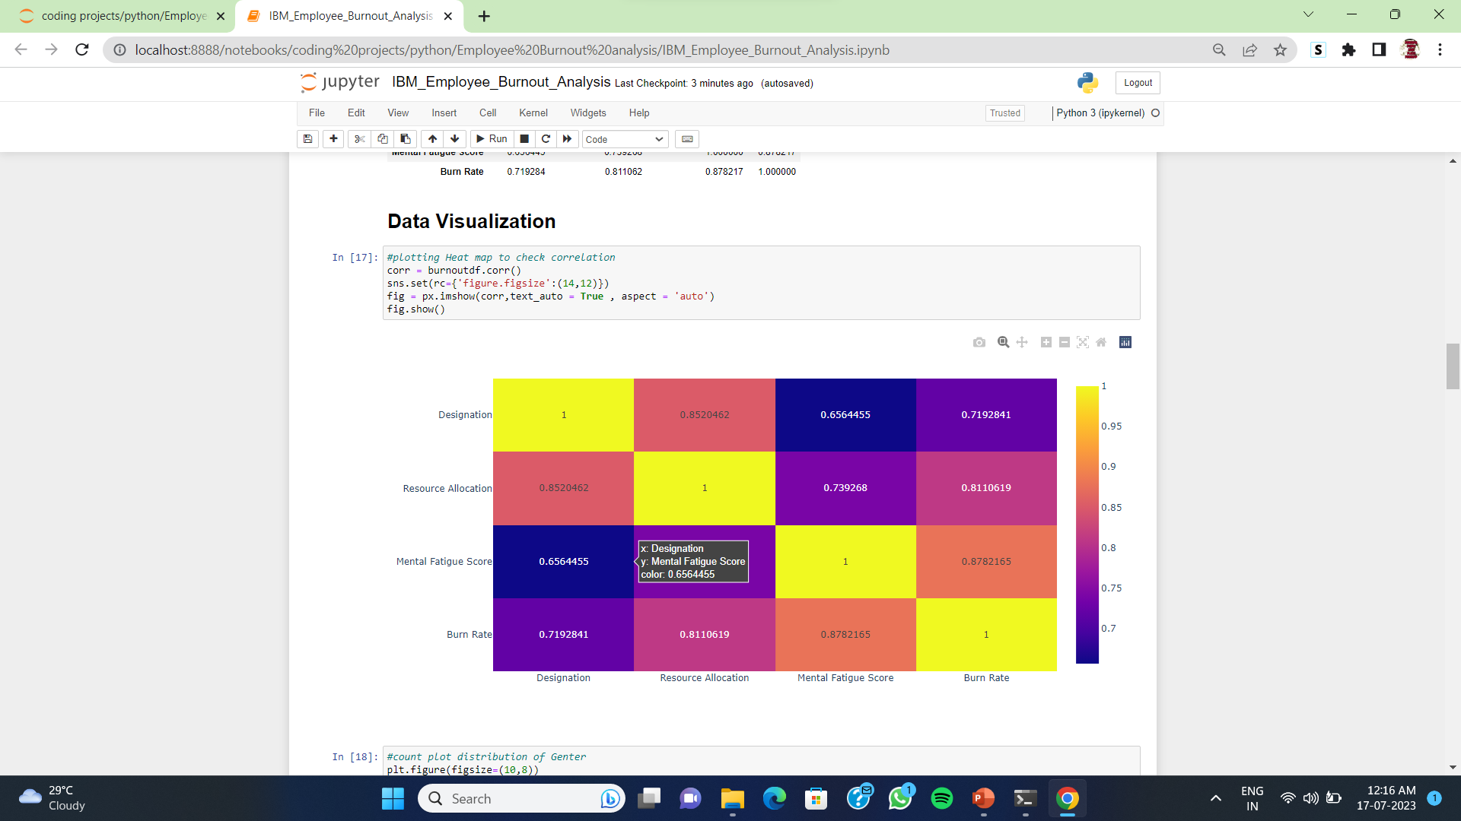

Slide 9
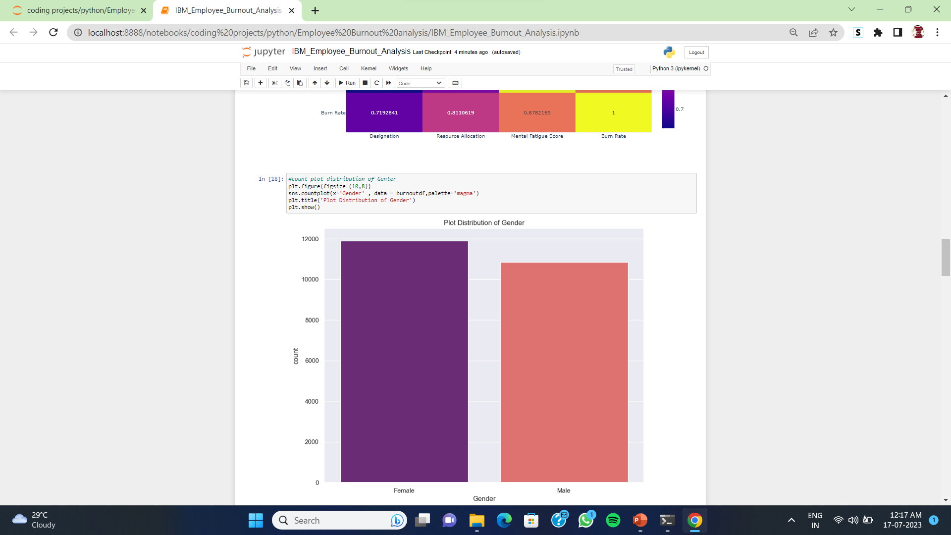

Slide 10
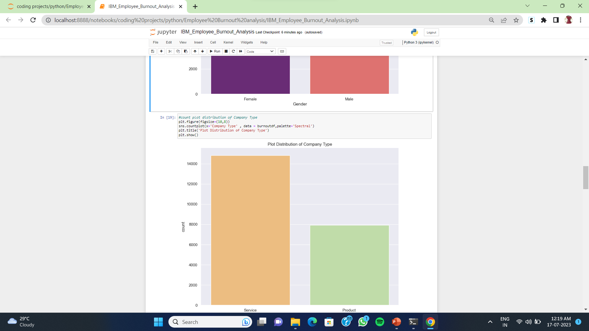

Slide 11
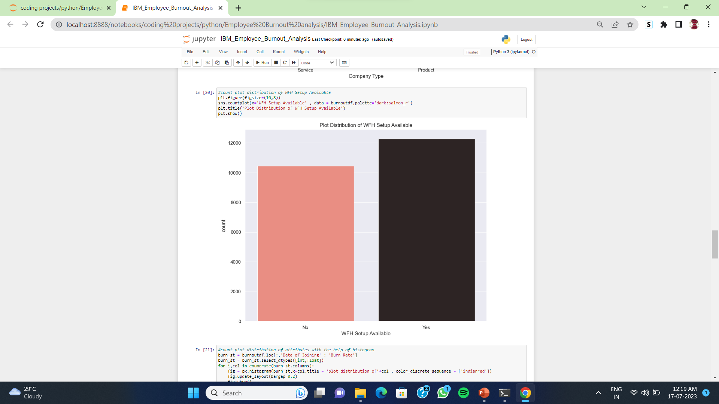

Slide 12
Data pre-processing

Slide 13
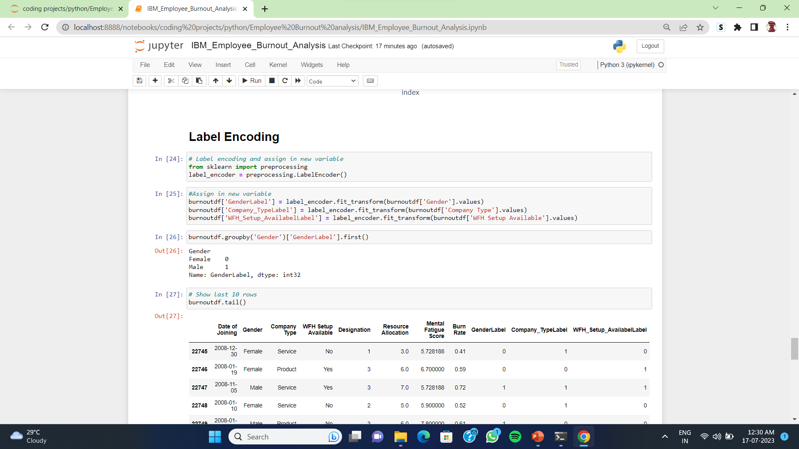

Slide 14
Random forest

Slide 15
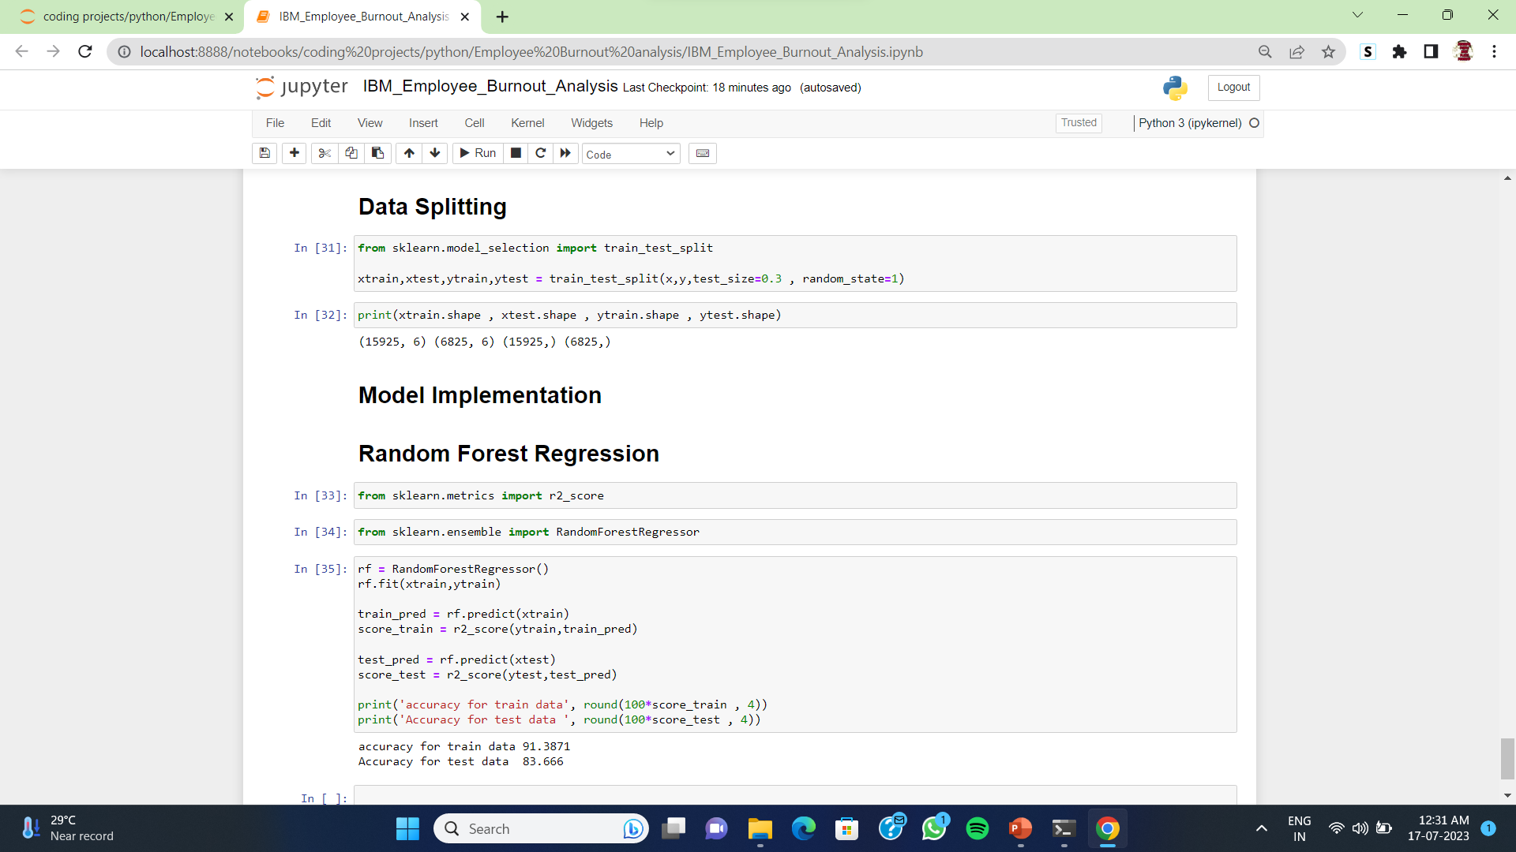

Slide 16
THANK YOU
Rachamadugu Sudheer Kumar
Email ID : rsudheerkumar40@gmail.com

